Slide 1




Group07
CSD201
SE1903
SNAKE HUNT
MENTOR: LE THI PHUONG DUNG
01

Slide 2
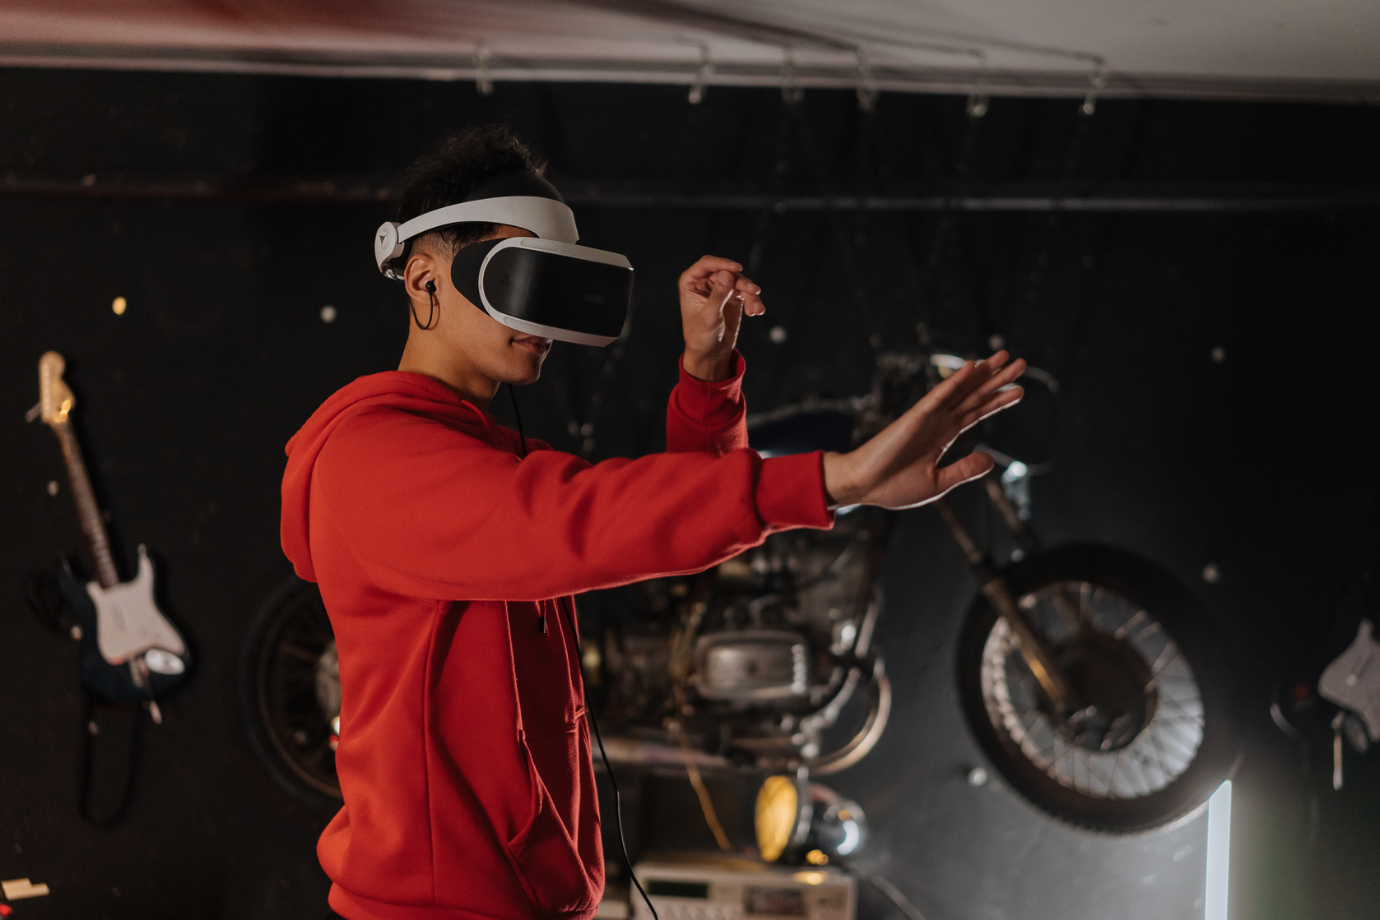
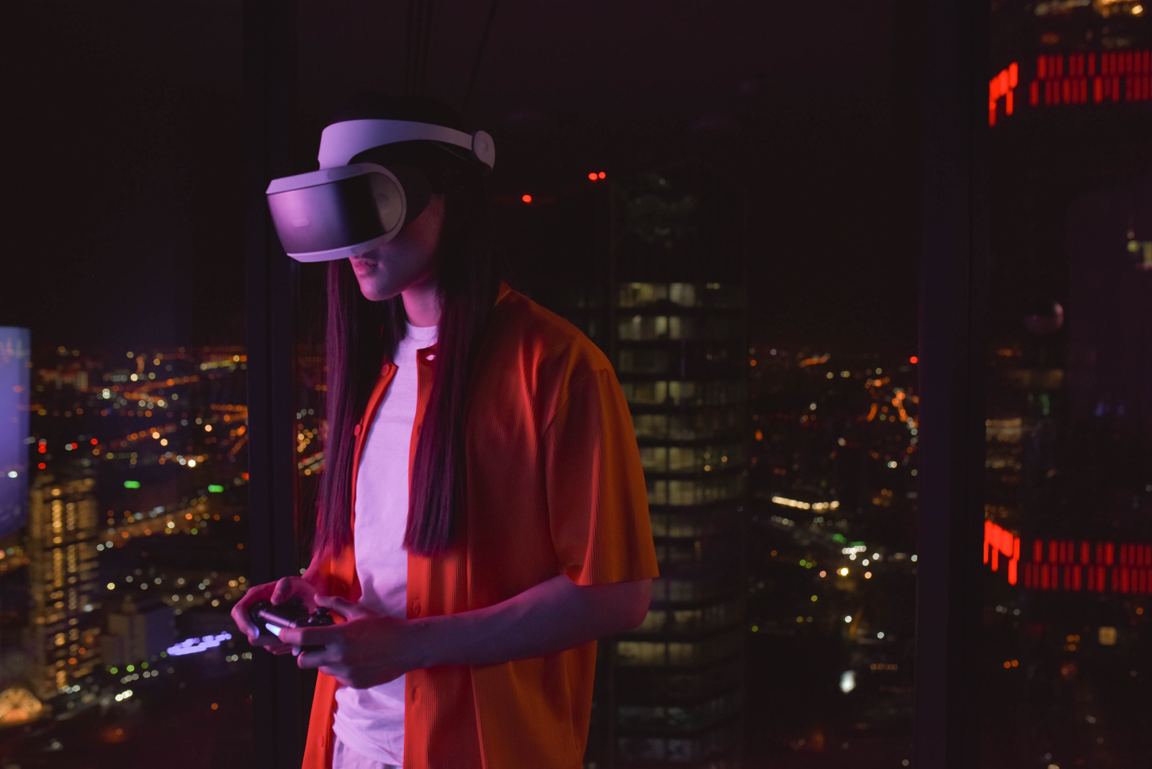
Group07
CSD201
SE1903
MEMBERS
Le Anh Tuan
Lim The Toan
Pham Gia Bao
Nguyen Minh Khang
02

Slide 3
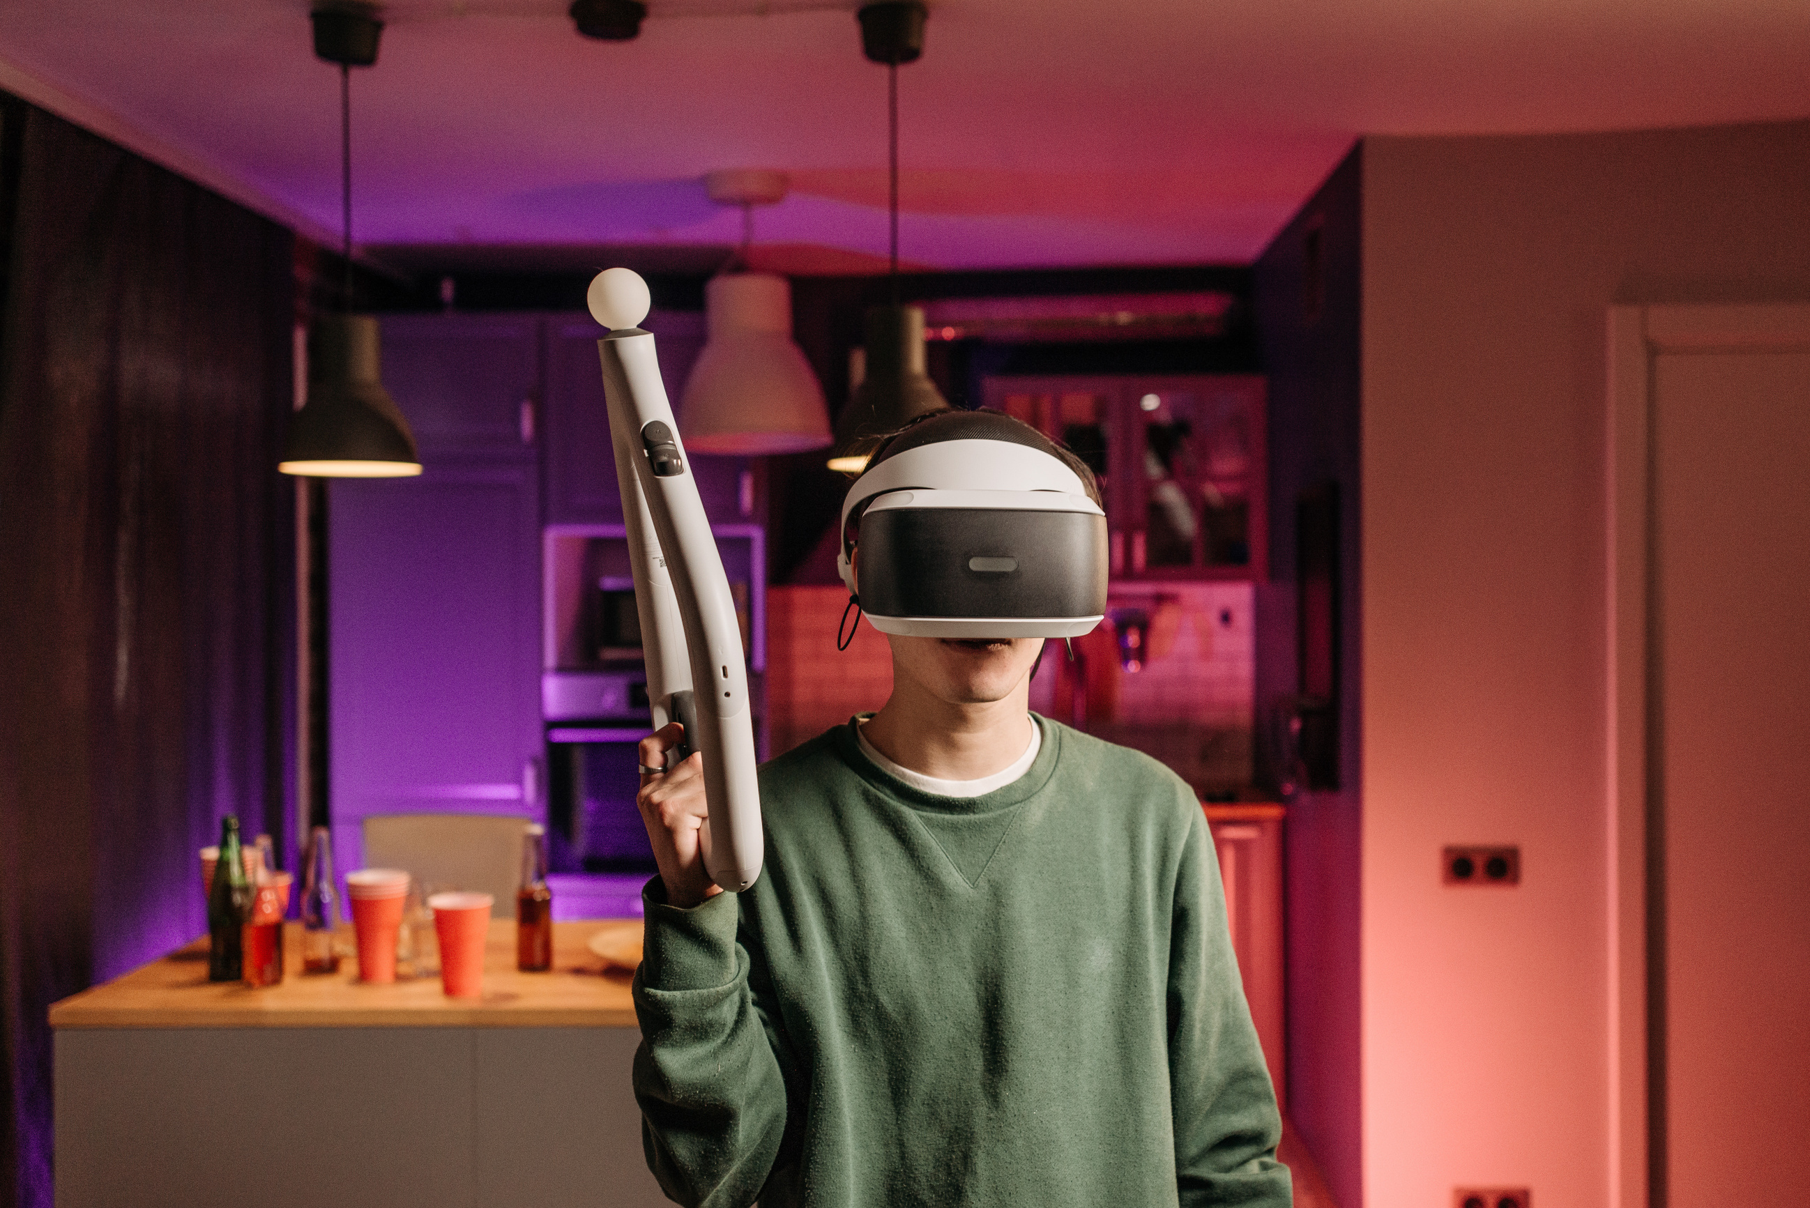
Group07
CSD201
SE1903
CONTENT
Introduction
Rules
Frame Interface
Q&A
03

Slide 4
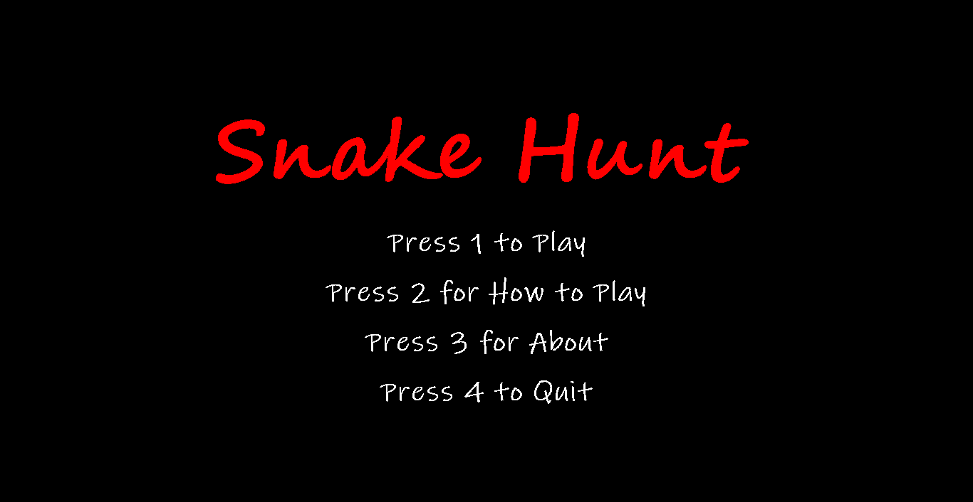
Group07
CSD201
SE1903
INTRODUCTION
04

Slide 5
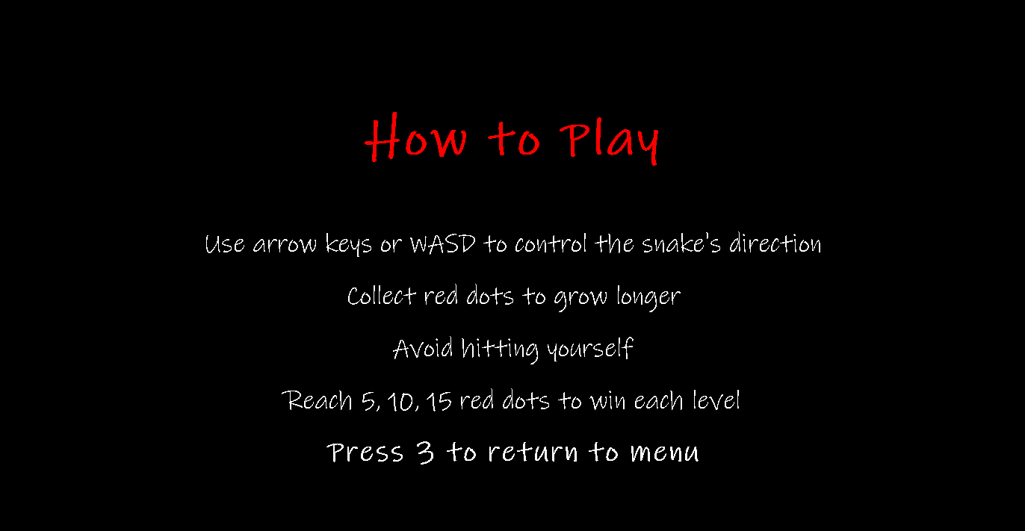
Group07
CSD201
SE1903
RULES
05

Slide 6
Group07
CSD201
SE1903
FRAME INTERFACE
MAIN MENU
06

Slide 7
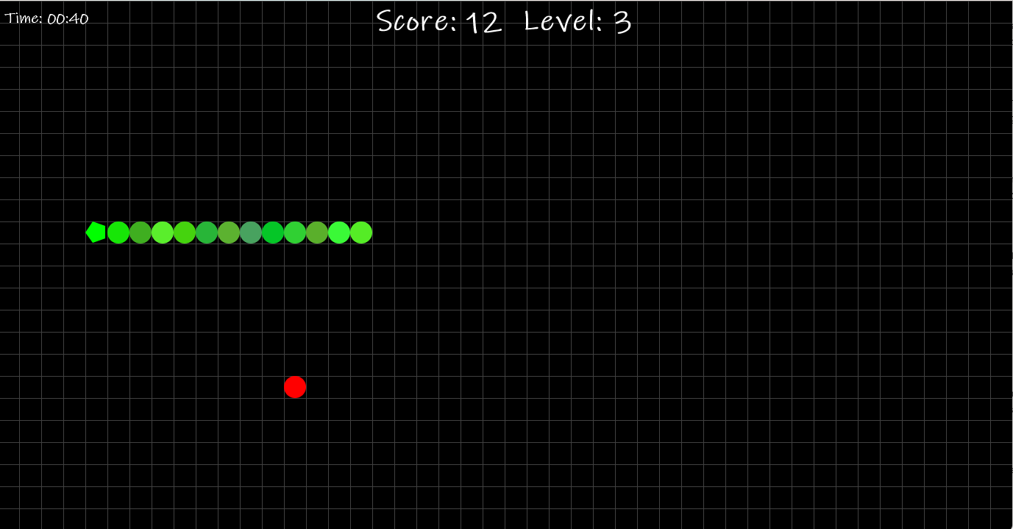
Group07
CSD201
SE1903
FRAME INTERFACE
GAME PLAY
07

Slide 8
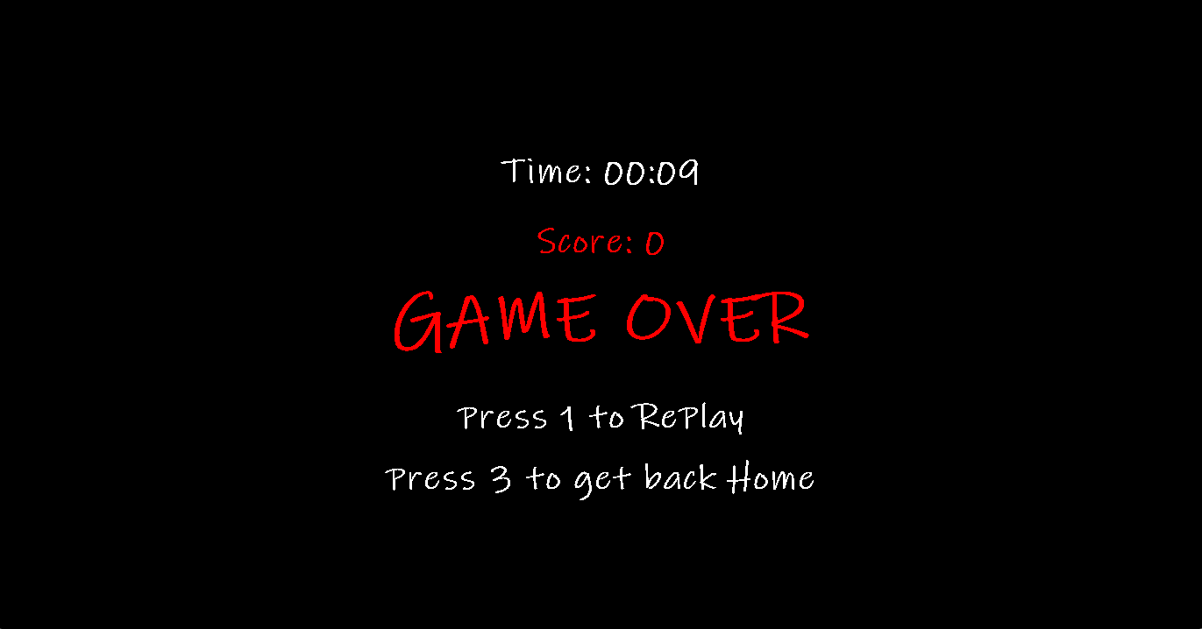
Group07
CSD201
SE1903
FRAME INTERFACE
GAME OVER
08

Slide 9
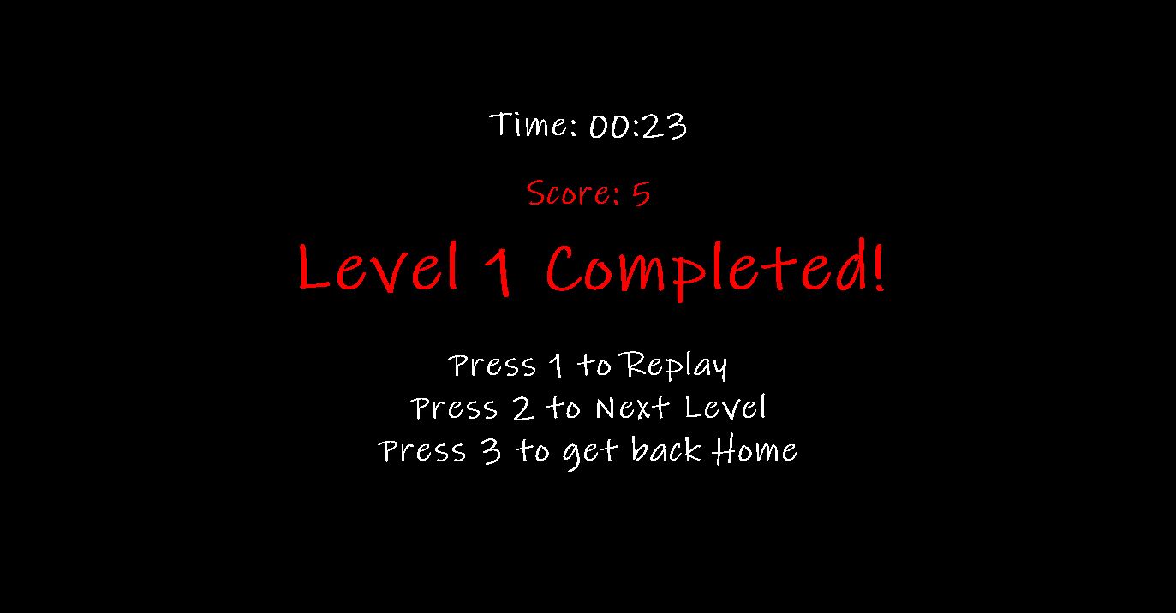
Group07
CSD201
SE1903
FRAME INTERFACE
LEVEL COMPLETED
09

Slide 10
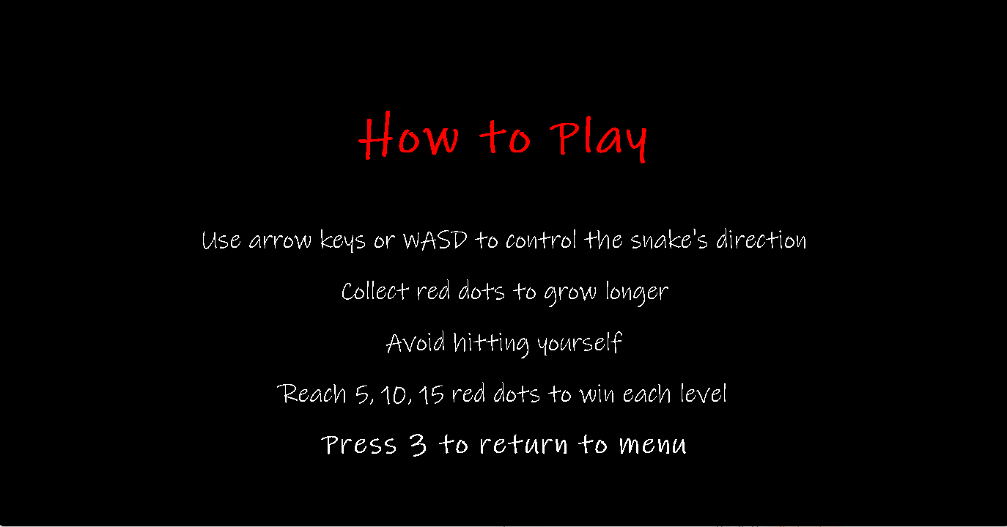
Group07
CSD201
SE1903
FRAME INTERFACE
HOW TO PLAY
10

Slide 11
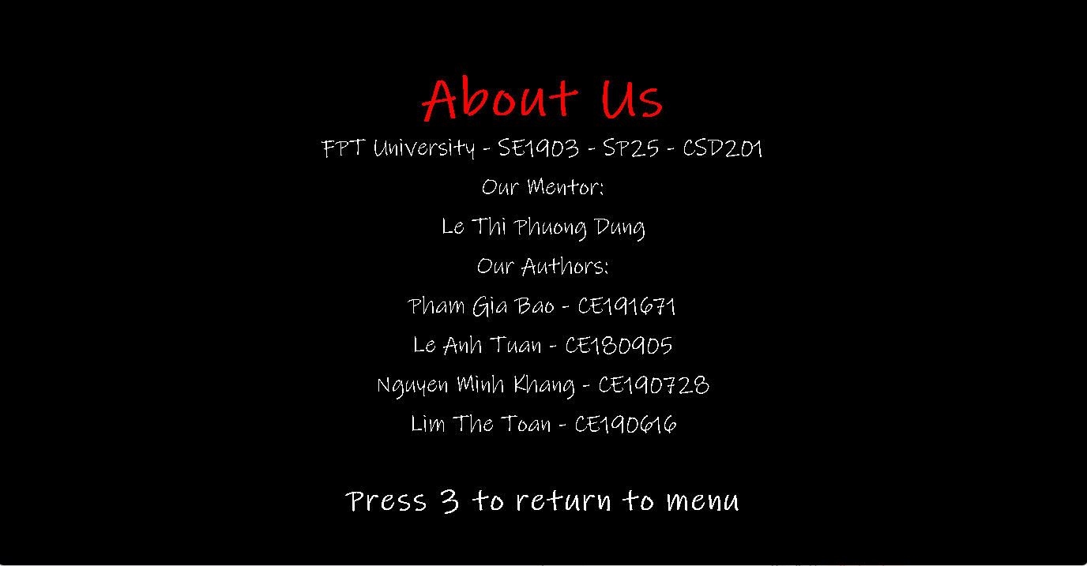
Group07
CSD201
SE1903
FRAME INTERFACE
ABOUT
11

Slide 12

Group07
CSD201
SE1903
FRAME INTERFACE
QUIT
12

Slide 13

Group07
CSD201
SE1903
FRAME INTERFACE
COMING SOON
13

Slide 14
Group07
CSD201
SE1903
DEMO
14

Slide 15
Group07
CSD201
SE1903
Q&A
15

Slide 16
Group07
CSD201
SE1903
THANK YOU
16

